Slide 1

Supply Chain Optimization Using Data Analysis & Forecasting
Leveraging data analysis and forecasting techniques to optimize key supply chain metrics and drive business improvements.

Slide 2
Supply Chain Optimization Using Data Analysis & Forecasting
Leveraging data analysis and forecasting techniques to optimize key supply chain metrics and drive business improvements.

Slide 3

Project Objectives
1
Identify Trends
Analyze historical data to uncover patterns in product performance, transportation, and defect rates.
2
Develop Forecasts
Build predictive models to anticipate future supply chain behaviors.
3
Propose Strategies
Recommend data-driven solutions to optimize costs and enhance product availability.

Slide 4
Supply Chain Challenges
Availability Issues
High Costs
Delivery Delays
Inefficiencies in product stock management and distribution.
Reliance on expensive transportation modes, leading to high logistics expenses.
Extended lead times affecting product delivery and customer satisfaction.

Slide 5

Data Overview
Product Categories
Skincare, Haircare, and Cosmetics data analyzed.
Key Metrics
Revenue, stock levels, availability, lead times, transportation costs, and defect rates.
Time Period
Data analysis covering [specify time range].

Slide 6

Data Analysis Techniques
Visualization Tools
Trend Analysis
Utilize Python libraries like Matplotlib and Seaborn for data visualization.
Identify historical patterns in sales, stock, and lead times.
1
2
3
Forecasting Models
Apply statistical models to predict future revenue, demand, and defect rates.

Slide 7





Key Findings
Revenue Trends
Skincare dominates, with growth potential in Haircare and Cosmetics.
Stock & Availability
Inefficient distribution leading to high stock but low availability.
Lead Time Challenges
Long lead times for high-demand products impact availability and satisfaction.
Defect Rates
Haircare products have the highest defect rates, signaling quality issues.

Slide 8

Forecasting Insights
Skincare Revenue Growth
5% projected increase next quarter
Demand for Low Availability Products
20% potential increase with distribution improvements
Transportation Cost Reduction
10% savings by shifting 20% of air shipments to sea
Lead Time Reduction
10% decrease with supply chain enhancements
Haircare Defect Rate Decrease
30% reduction through improved quality control

Slide 9
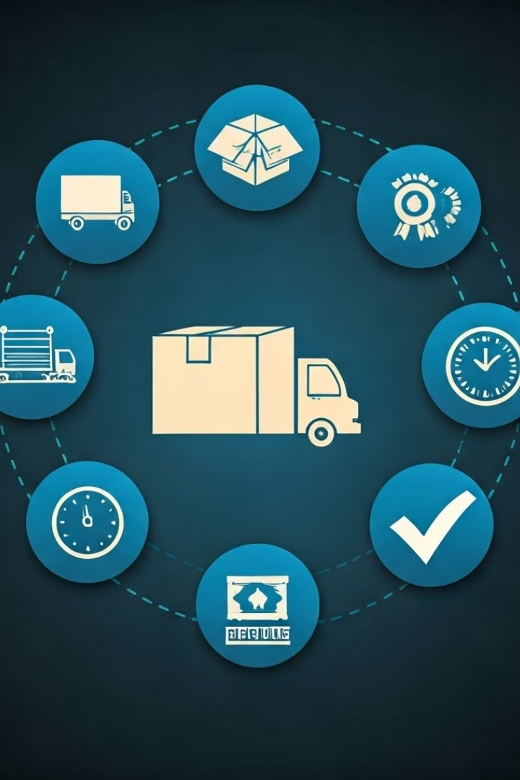



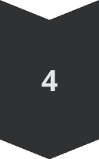
Optimization Strategies
Transportation
Shift non-urgent shipments to sea transport to reduce logistics costs.
Inventory Management
Address stock distribution challenges to improve availability.
Lead Time Reduction
Focus on supply chain bottlenecks to decrease lead times.
Quality Control
Implement tighter quality processes to reduce defect rates.

Slide 10

Implementation Plan
1
Prioritize Distribution
Address stock and availability mismatches.
2
Optimize Transportation
Reduce air transport usage and shift to sea.
3
Enhance Quality Control
Implement new protocols to address high defect rates.
4
Continuous Monitoring
Refine forecasting models with new data.

Slide 11
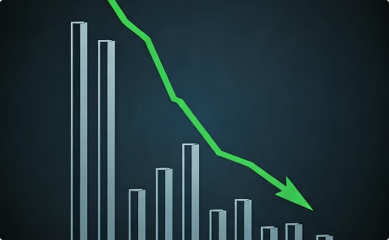
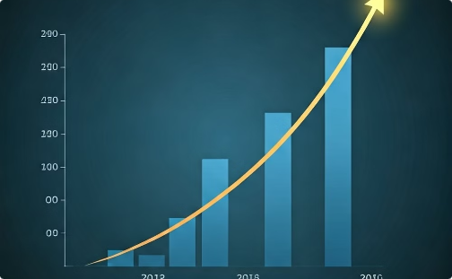
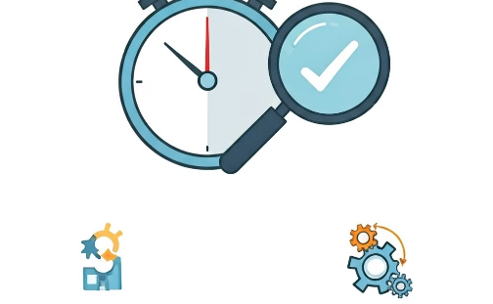
Impact & Benefits
Cost Savings
Revenue Growth
Operational Efficiency
10-15% reduction in transportation and logistics costs.
Up to 5% projected growth by optimizing availability and demand.
Improved lead times and reduced defect rates for enhanced customer satisfaction.

